Slide 1

The European Nucleus Optical Network
SpaceOps2021 May, Cape Town
Martin Krynitz, Hennes Henniger (KSAT)
Klaus-Jürgen Schulz, Clemens Heese, Holger Dreihahn (ESA-ESOC)
Marcus Knopp (DLR-GSOC)

Slide 2
Scope
Terrestrial Optical Communications has changed the Internet
Will Free Space Optical (FSO) Communications change Space business?
The challenge is the atmosphere while a vacuum is perfect for FSO
Many stand-alone optical stations have been built
No operational service exists
The European Optical Nucleus Network wants to change that

Slide 3
Industry and Agencies have the same goal
Make FSO as operational as Radio Frequency Communication
Augment existing RF Networks
Build an automated network with multiple stations
Unleash the full potential of FSO →100s of Gbit/s
Shape an alternative to RF for Lunar and Deep Space high speed communication
Leverage the existing terrestrial technology developments

Slide 4
What is the European Nucleus Optical Network?
The founding partners are ESA-ESOC, DLR-GSOC and KSAT
All parties buy their own Optical Station
The stations must be (made) CCSDS compatible
The stations are connected in a single network
Parties cooperate on recommendations for selecting equipment

Slide 5
What is the European Nucleus Optical Network (2)?
Parties cooperate on necessary developments
Parties strive to reach increasingly higher service levels
The network is marketed as one
The network is open for use to other Agencies and Industry
Once the market develops the nucleus network will be succeeded by fully commercial networks

Slide 6
Challenges
Licensing
  In theory simpler
  National laser regulations are applicable
  May lead to increase of price
Cost miss-match
  Operations need to be compatible with RF services
  Existing COTS need modifications
  Multi site approach needed for acceptable Service Level

Slide 7
Challenges (2)
Multi Mission
  Lack of standardization
  Proprietary equipment needed:
    Optical Modems
    Optical Receivers
    Beacon Frequency
Impact on CONOPS
  More decision power to satellite and ground stations
  Onboard file replication service

Slide 8
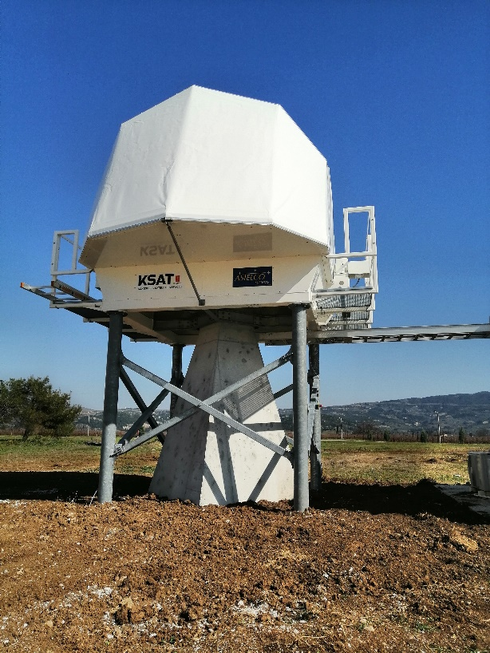
The Nucleus Stations

Slide 9
Future
Mending the network together and operationalize it
Test with Tesat PIXL mission
Support TOSIRIS on Bartolomeo on ISS
Extend network with more partners
Achieve a more global footprint
Implement the full CCSDS standard stack once agreed
Support missions with CONOPS adapted to FSO

